Slide 1
The evolution of the school population in Galati after 1990

Slide 2
The evolution of the number of inhabitants in Romania in the last two decades shows a population decline, from 23.3 to 19,600,000 inhabitants, i.e. a decrease of 16% of the population.
The percentage of Galati population decreased by 24.5% and 22% in the county in 2011 compared to 1992.

Slide 3
The demographic behavior in Romania over the last two decades got closer to the European one, so the birth rate, the main indicator which increases the population of a region, fell below alarming rates. We can add high emigration, resulting in a negative migration balance, all these diminishing the resources of the country's youth. The percent reduction is nearly 9%, from about 24% in 1990 to just over 15% in 2011 (Figure 1). If we consider that many of these young people will migrate attracted by the Western European labor market which is much more attractive, that will mean that in the very near future we will not cover all the needs of the labor market.

Slide 4
At the level of the school population, according to INS, in 1990 this was 5,066,000 people.
In 2011, according to the data released by INS the school population reached 4.03 million, registering a decrease of 1 million compared to 1990 and is distributed as follows: pre-school students- there is an increase compared to the previous years, the number of students in primary and secondary education decreased at about 1.01 million compared to 1990, ranging 94-95% of children who were of school age, resulting in the 5-6% dropping out; enrollment of pupils in secondary education between the ages of 15 and 18 was 81% nationally, one in five high school students dropping out high school. The population included in the university system peaked in 2008 and then began to decline due to a weaker graduation rate in the final examination (baccalaureate supported many students who attended the progressive route to which we can add the video monitoring and improving security in the exam rooms). The tripling in the number of students is caused by the emergence of numerous private colleges, of supplementing places in the state system, compared to 1990. As enrollment rates of the population in this system, in 1990 only 10% got higher education, compared to 56% in 2011.

Slide 5
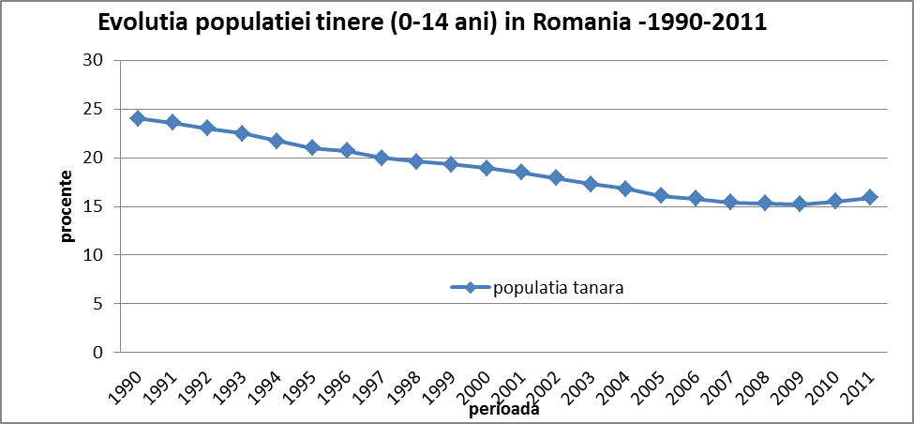
Sursa: pe baza datelor preluate de la INS

Slide 6
EVOLUTIA POPULATIEI SCOLARE
Sursa: pe baza datelor preluate de la INS

Slide 7
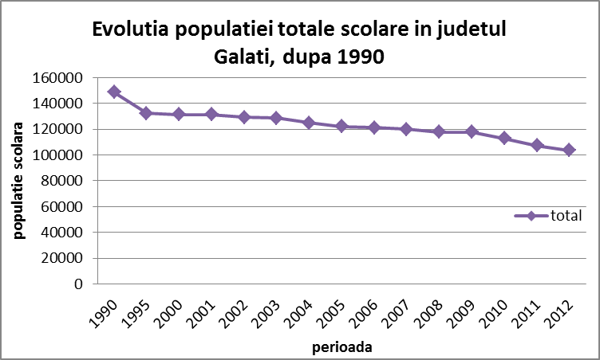
modificările legii învăţământului,
evoluţia societăţii în perioada postdecembristă
caracteristicile indicatorilor demografici – natalitate, nupţialitate

Slide 8
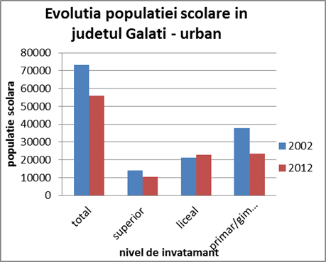
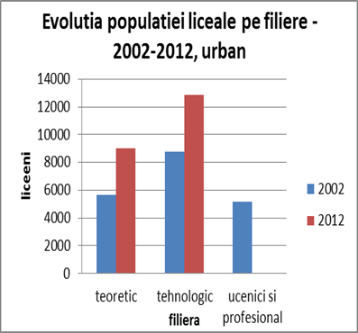

Slide 9
How many children are there?
Reducing school population from 21,097 to 16,375 students represents a 22.4% decrease in the number of students, even if in 2013 were caught 9 levels of education, and not eight, as in 2002;
If the decrease will have the same downward trend, just by keeping the rate of 22% in 12 years, it means that in 2024 primary and secondary school students will be 3602 less than in the early 2013, and for another 12 years - i.e. 2035 the school population will reach up to 10000, respectively, less than half, compared to 2002;

Slide 10
The evolution of the school population, a comparative and temporal presentation on each level of education
The most obvious decrease can be observed in the primary-secondary education level between 1990 and 2012 quotas contained in the eight years of study represent only 60% of the total in registered in 1990. The increase in 2012 is determined, not by an increase in the number of children in the county, but by the introduction of class 0, so the worth-considering number of years increased to 9. This change in the primary-secondary level is closely related to the decline of preschool population, the 3000 students who suddenly disappear from the preschool are reflected by the increase in the primary level.
At the high school level the number of students decreased after 1990, following the dropping out of compulsory education of 12 classes, followed by a constant current, at least for the period between 2000 and 2008. The increase after 2008, is not due to increased quotas of the school system, but by the disappearance of vocational schools and the establishment of classes of progressive route, observing, in parallel, a decrease in this category, their re-establishment in 2012 causing duplication of the students enrolled at this level.

Slide 11
The only level that recorded since 1990 more growth is the superior one. It can highlight the factors that led to the increasing number of students:
- The emergence of the private education system, in 1992 the Danubius University was founded;
- The Reform of the university education in 1999 increased the number of students at the University Dunarea de Jos of Galati, by increasing the number of faculties from 11 to 13, increasing the number of majors from 73 to 88;
- Danubius University student numbers increased from 100 in the year of establishment to 2500, full-time students, part-time and distance;
- A factor that increased the number of students and influenced directly the number of employees was placing in 1999, open and distance education, the emergence of tax places besides the budgeted fee.
After 2010 the number of students is reduced due to the lower proportion of baccalaureate graduates, Galaţi being the last on top; the vast majority of students are local or come from neighboring counties. During 2008-2009 should be noted that a lot of high school students choose to study at universities abroad, reducing the university school population, joining the European Union in 2007, making it easier than this type of migration.

Slide 12
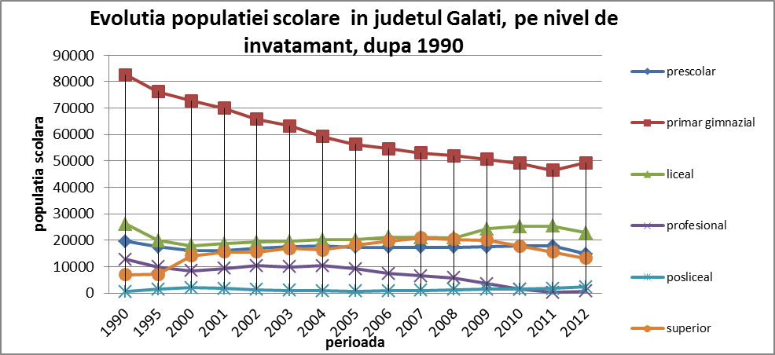
Sursa: pe baza datelor preluate de la DJS Galaţi

