Slide 1
“Mircea Eliade”
Theoretical
High school,Galati Romania

Slide 2
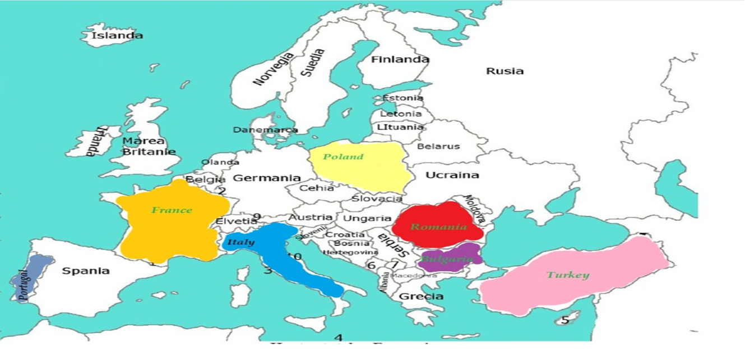
E U R O P E
I love my future as a European Citizen

Slide 3
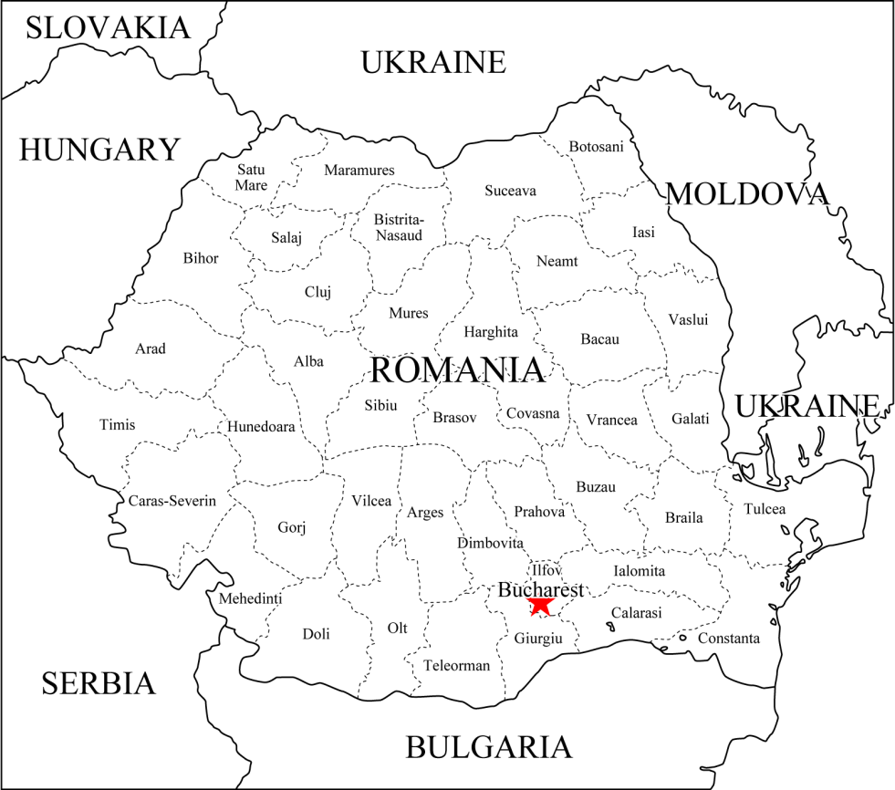
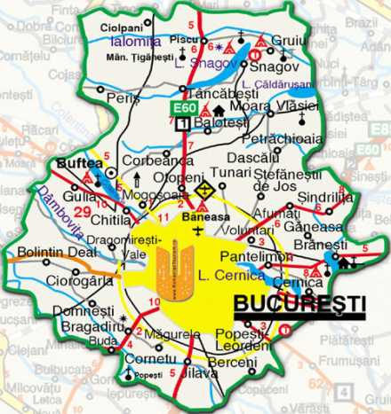
My country Romania
Romania is a country located at the intersection of Central and Southeastern Europe, bordering on the Black Sea. Romania is the eighth largest country of the European Union by area, and has the seventh largest population of the EU. Its capital and largest city is Bucharest - the sixth largest city in the EU.
Bucharest is the capital municipality, cultural, industrial, and financial centre of Romania. It is the largest city in Romania, located in the southeast of the country.

Slide 4
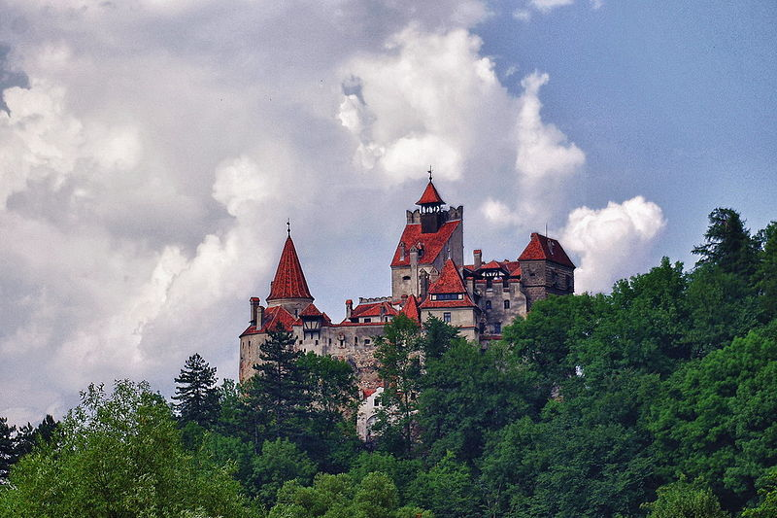
The main attractions of Romania
The Bran Castel
Bran Castle, situated near Bran, is a national monument and landmark in Romania.. Commonly known as "Dracula's Castle" , it is marketed as the home of the titular character in Bram Stoker's Dracula.

Slide 5
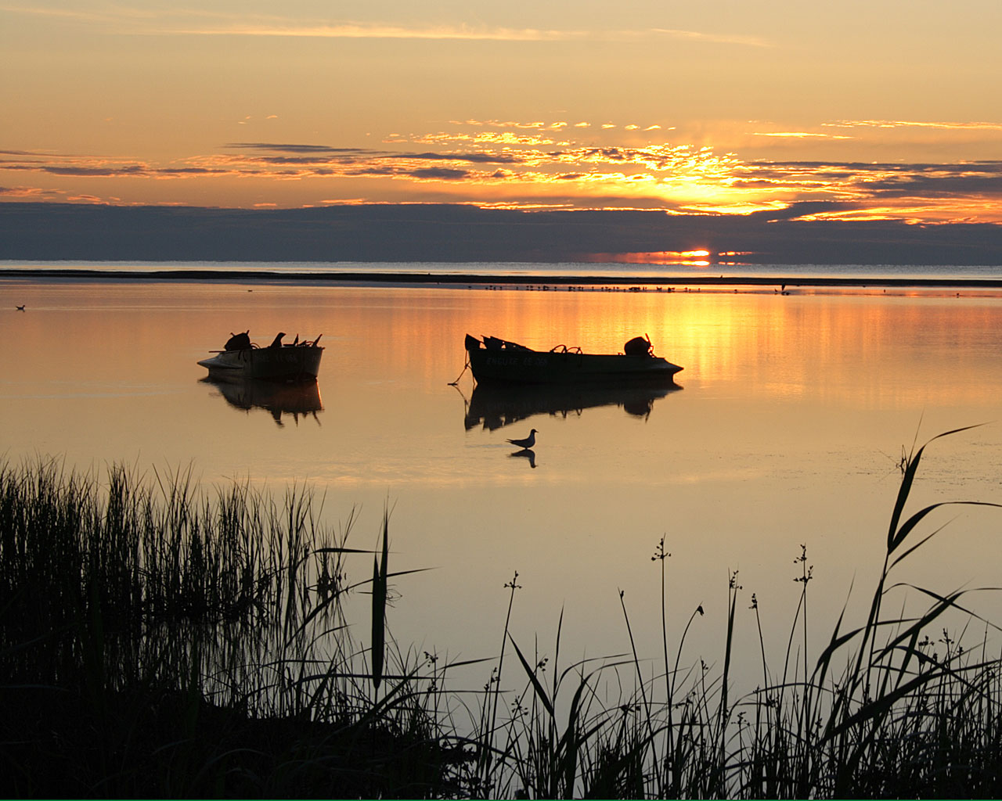
The Danube Delta
The Danube Delta is EUROPE'S NEWEST LAND and one of the most impressive areas in Europe. Not only is it part of UNESCO World Heritage, since 1991, but the Danube Delta is also the best conserved of European Deltas.

Slide 6
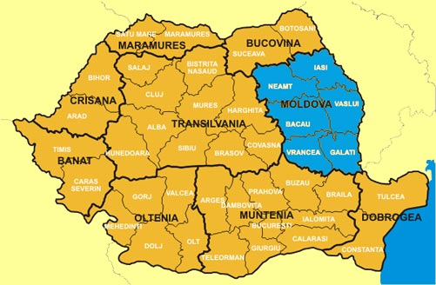
Romania Moldova Region

Slide 7
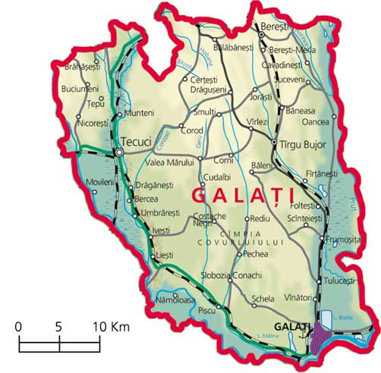
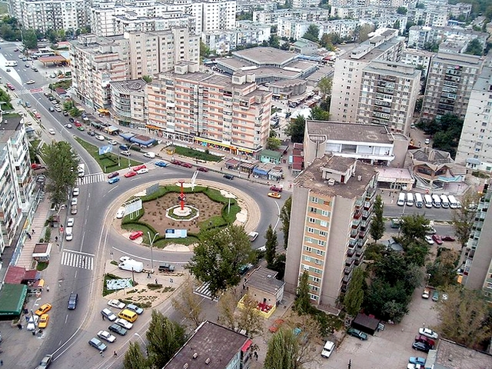
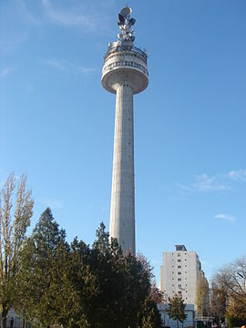
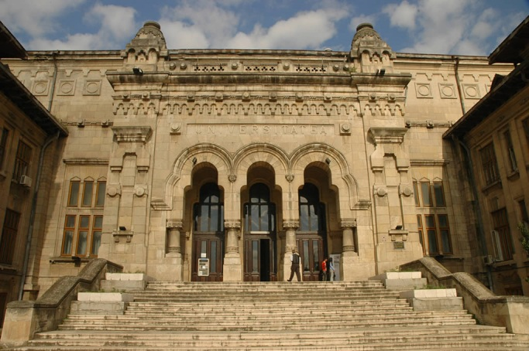
GALATI
Panoramic view
‘”Dunarea de jos” University

Slide 8
Our city…Galati
Galati is the capital and also the largest city of Galati county. It is one of the largest economic centers in Romania. Galati city has a history because it is charged and placed on the Danube, the most important artery of trade and European river, the Rhine-Main-Danube Canal.

Slide 9
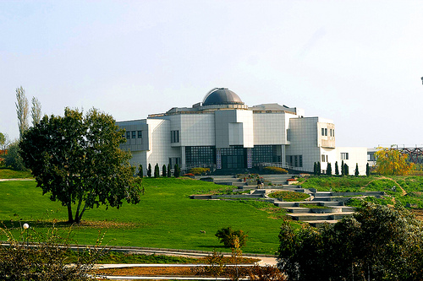
Attractions in Galati
The Botanical Garden
Included in the Museum of Natural Sciences, the Botanical Garden dominates the left bank of the Danube. Fitted with 2 greenhouses with exotic plants, a lake with water lilies, a Japanese garden and a waterfall in miniature.

Slide 10
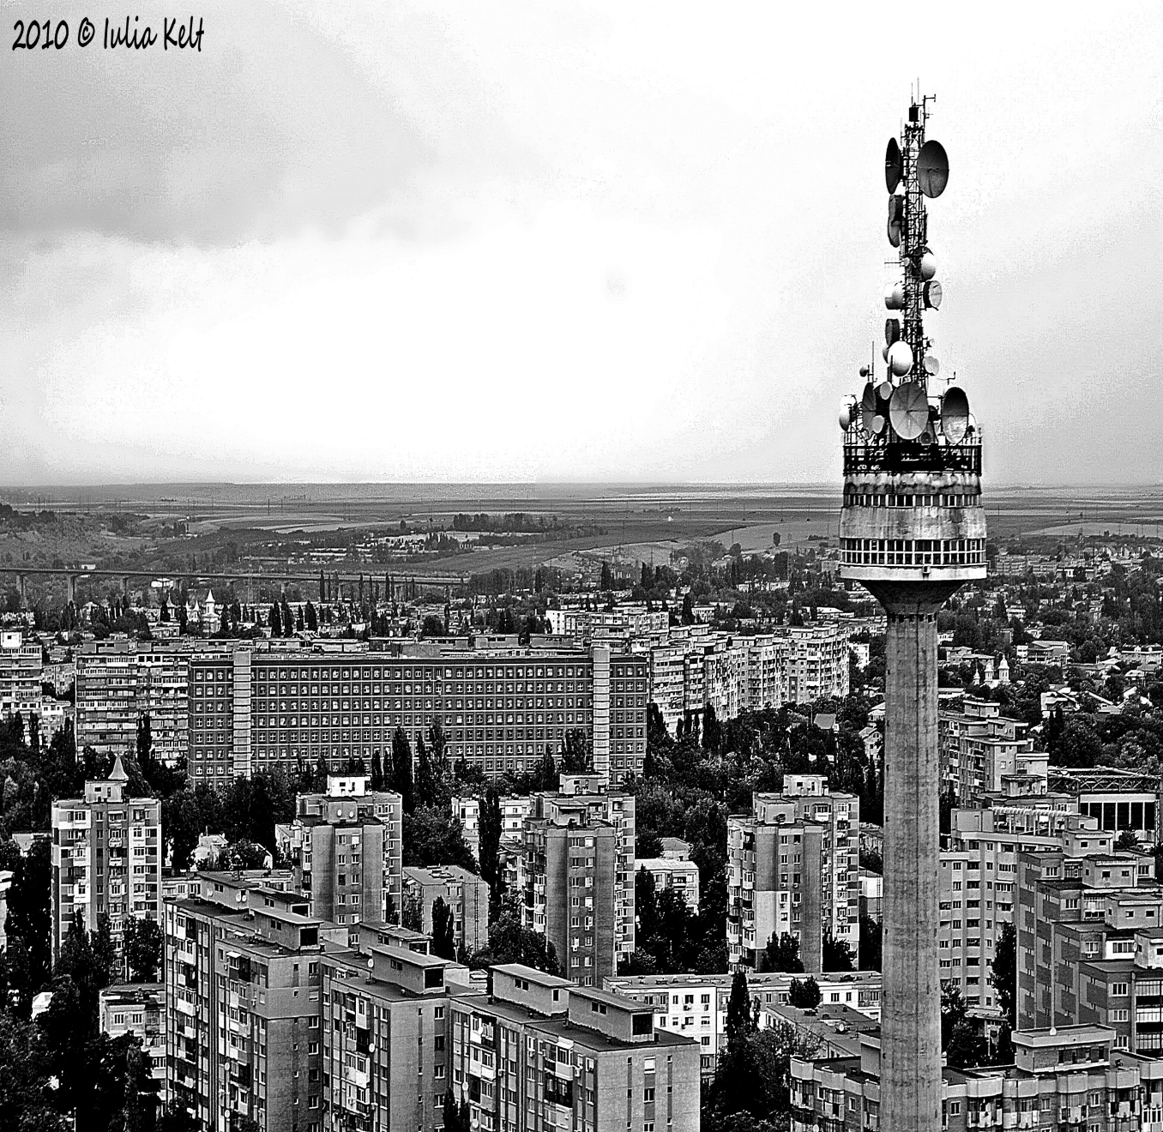
Galati TV tower
Galați TV Tower is a 150-metre tall concrete tower used for FM and TV broadcasting in Galați. The tower, is equipped with a tower restaurant, perhaps the only one in Romania. It dominates the city being the tallest building in town.

Slide 11
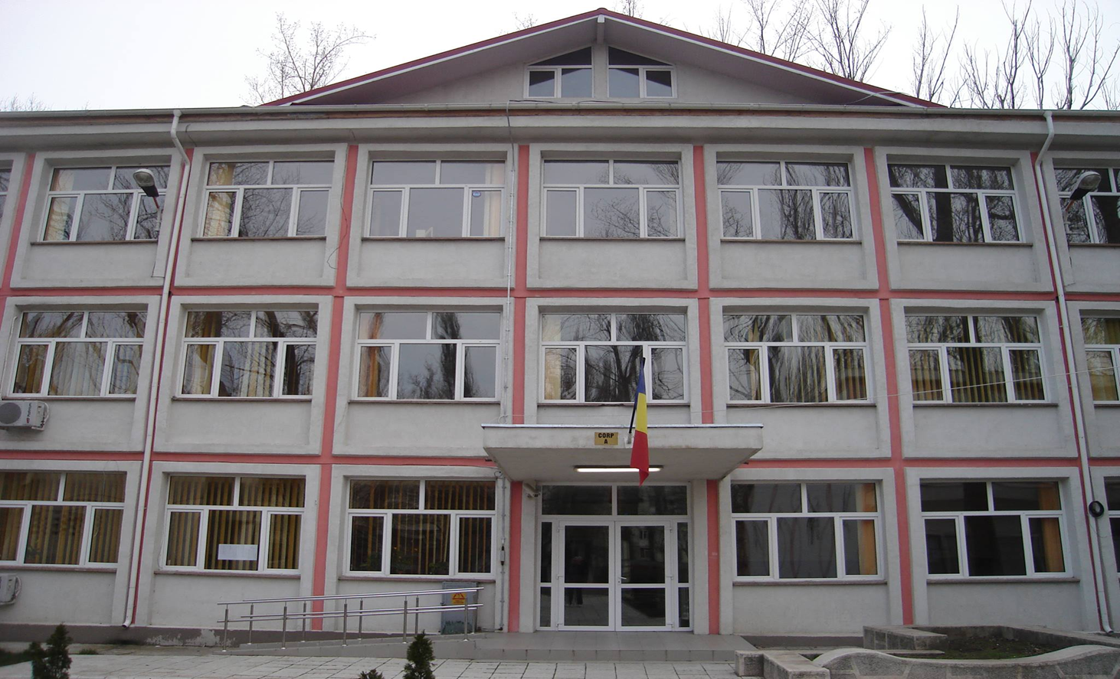
Our school
Our school is The Theoretical High School Mircea Eliade Galati. It is a modern high school equipped with everything to make classes fun and useful. In here we are not learning only information that make us smarter persons but life principles. Of course I think that our school is the best school….ever!

Slide 12
The End Thank you for your attention and I hope you have enjoyed the presentation!
This project has been funded with support from the European Commission.
This publication [communication] reflects the views only of the author, and the Commission cannot be held responsible for any use which may be made of the information contained therein.

