Slide 2
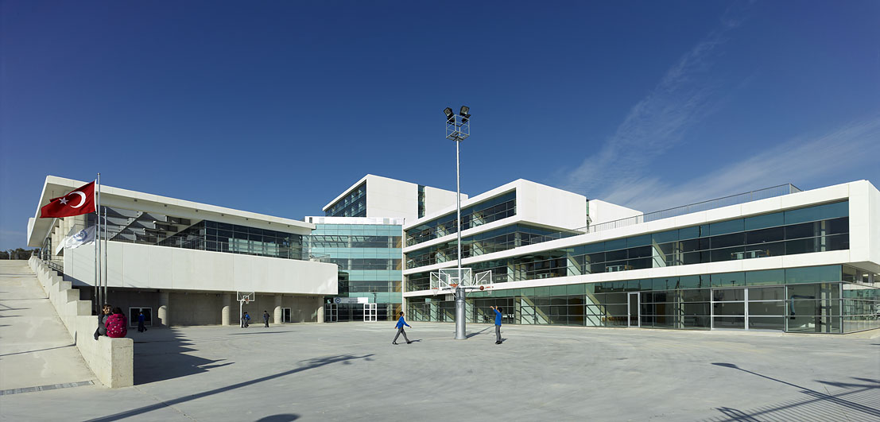
OIB Vocational & Technical Anatolian High School

Slide 3
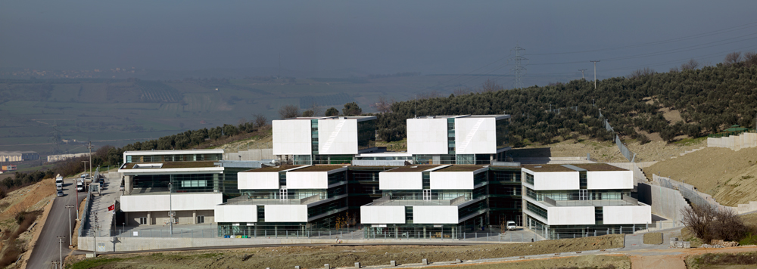
At the end of 2007, In order to provide a solution to the problem of qualified personnel in the automotive sector, with the decision of the Board of Directors of Uludağ Exporters' Associations (UIB), Automotive Industry Exporters’ Union (OIB) decided to set up our school.

Slide 4
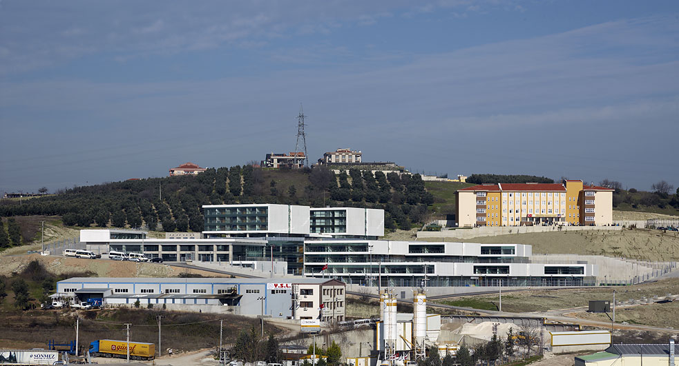
After the constructıon period our School started education in the 2010-2011academic educational year with a capacity of 720 students at the end of the 4th year.

Slide 5
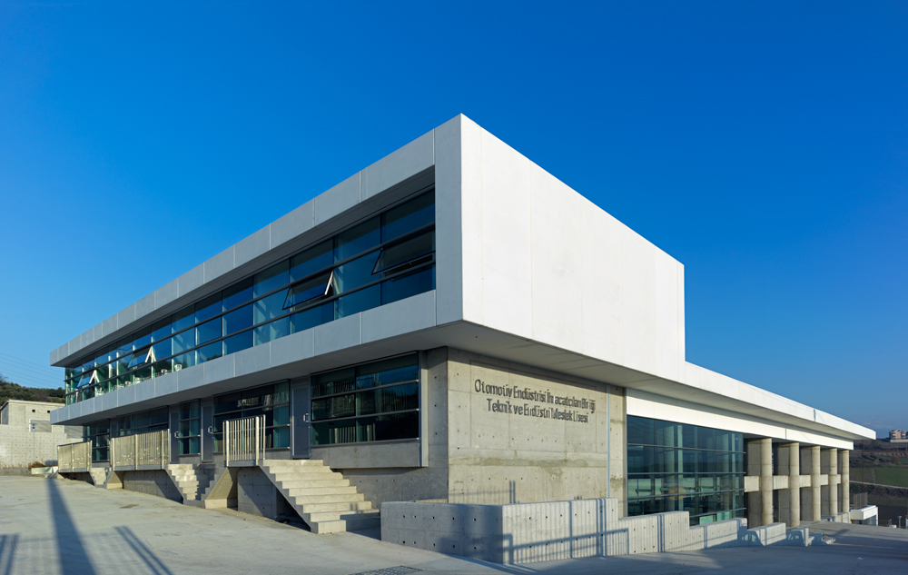
OIB Vocational & Technical Anatolian High School started education with 180 students in the 6 following fields.

Slide 6
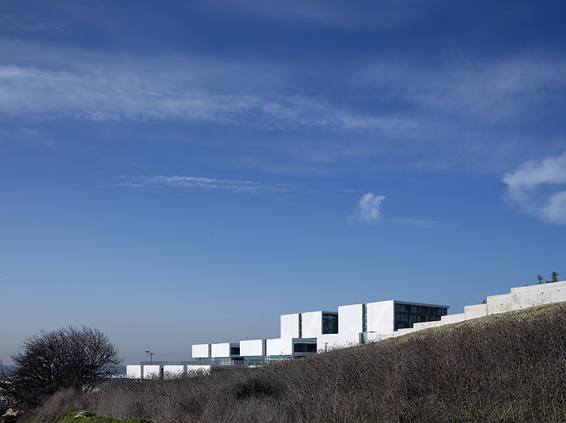
Information Technologies,
Electrical & Electronics Technologies,
Industrial Automation Technologies,
Machinery Technologies,
Metal Technologies,
Motorized Vehicles Technologies.

Slide 7
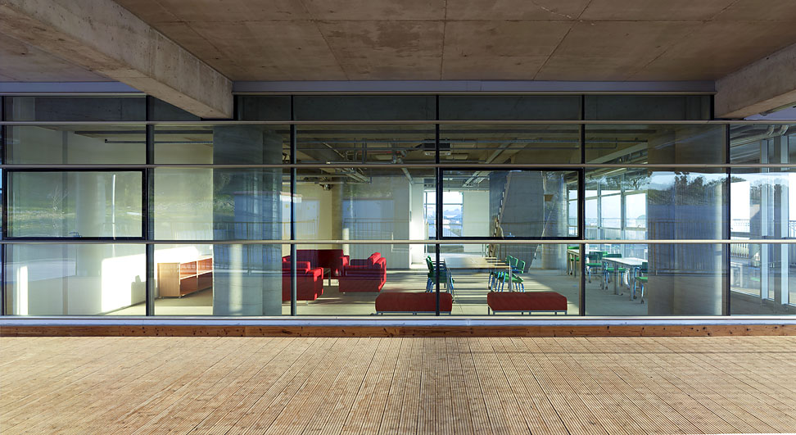
There is a dormitory with the capacity of 300 students.
(250 for boys 50 for girls.)

Slide 9
There is a 720-seat in door sports hall

Slide 10
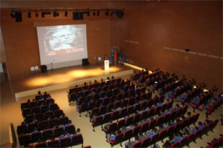
511-seat conference hall

Slide 11
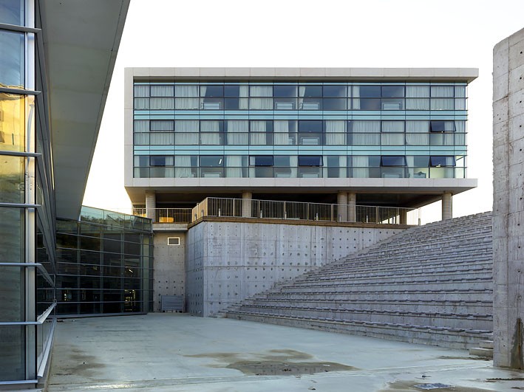
an open – air amphitheater

Slide 12
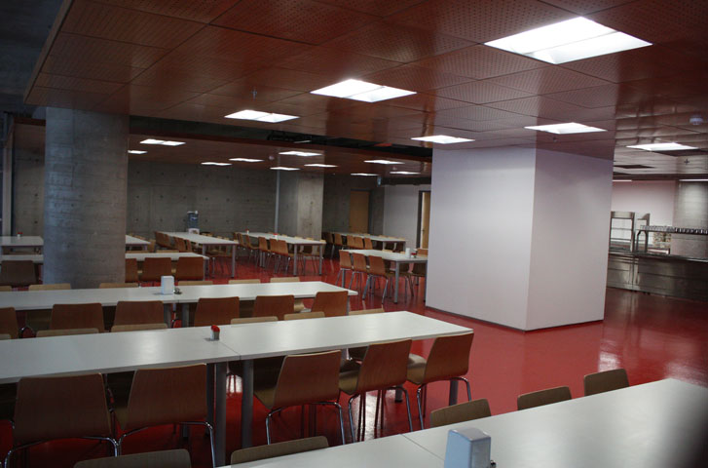
School Cafeteria

Slide 13
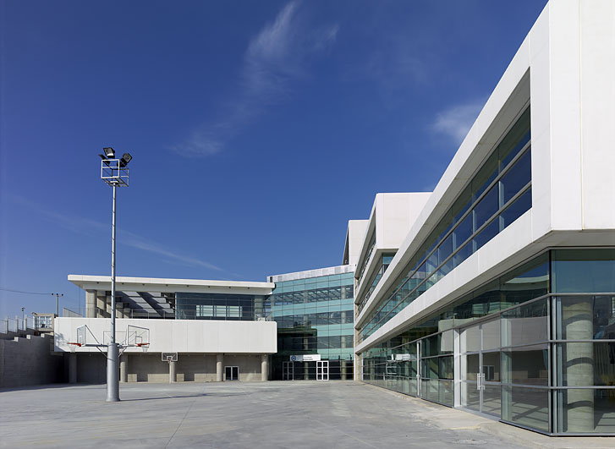
In the first academic year in 2010, we started with a school principal, 2 vice principals & 15 teachers.
Now…
We are 66 all together

Slide 14
Our aim:
Having close relationships with the automotive industry, our school aim is to provide quality education to meet the needs of the sector.
And by following technological innovations closely, to provide students a bright future is our aim.

Slide 15
EU PROJECTS
Leonardo Da Vinci – Transfer of Innovation (2010-12)
Grundtvig Project (2012-14)
Commenius Billateral (2013-2015)
KA2 (2014-16)
KA1 (2014-16)

Slide 16
A few other photos…

Slide 19
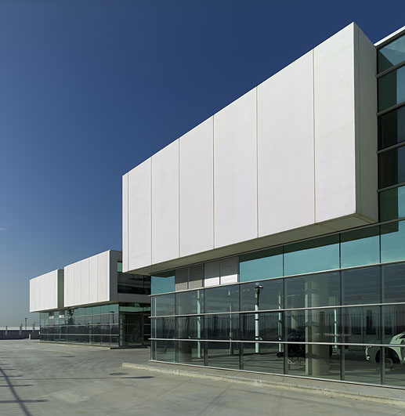

Slide 20
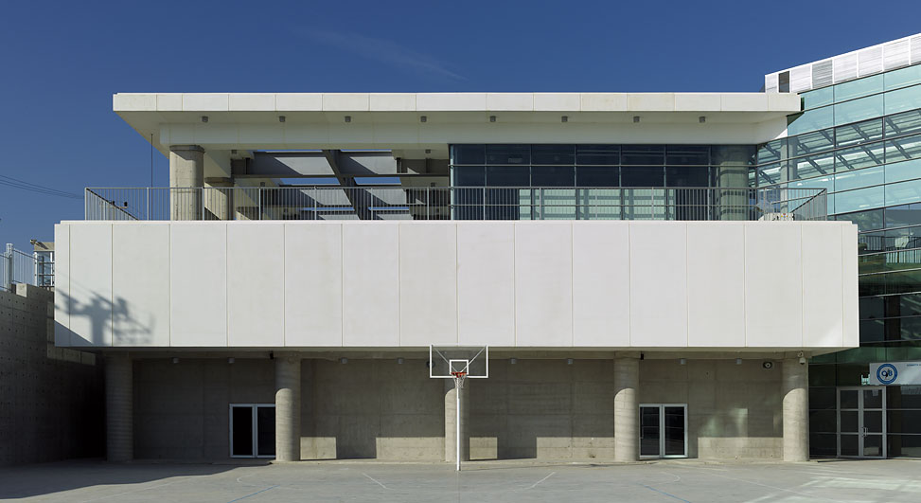

Slide 21
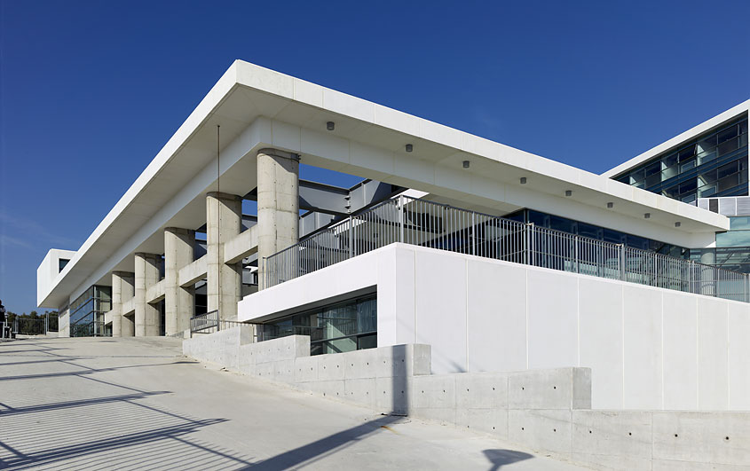

Slide 22
Thank you…

