Slide 1
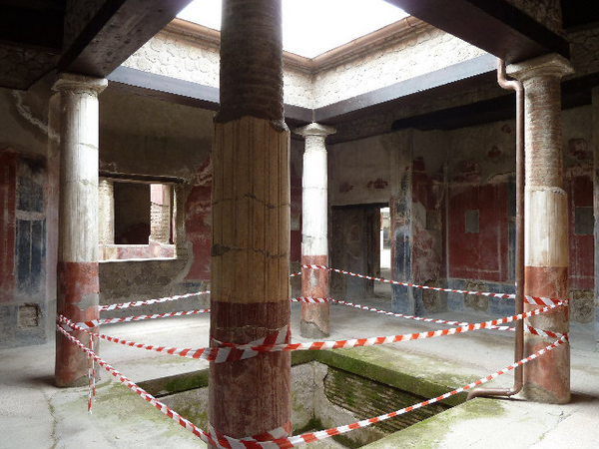
From the ancient stabiae 79 a.c.
Atrium of villa San Marco

Slide 2
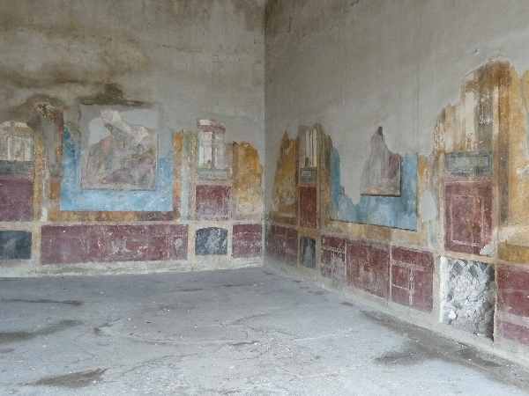
From the ancient stabiae 79 a.c.
Villa Arianna - myth room

Slide 3
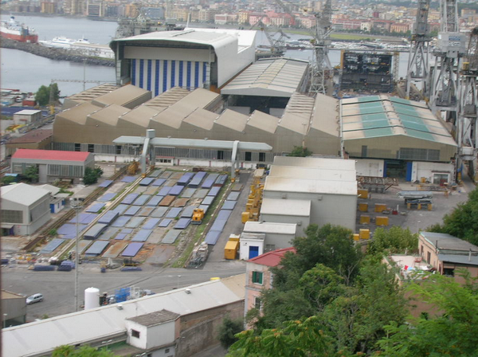
To Castellammare di Stabia
Shipyard

Slide 4
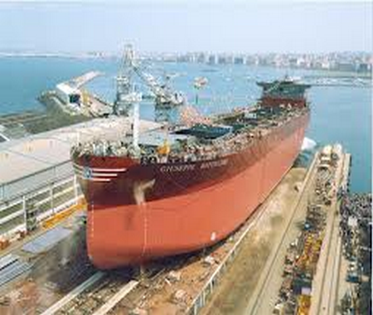
To Castellammare di Stabia
Shipyard - launch

Slide 5
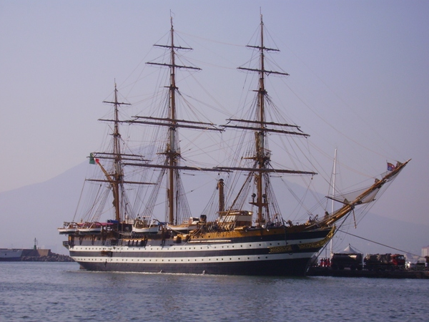
To Castellammare di Stabia
training ship Amerigo Vespucci was built here in 1931

Slide 6
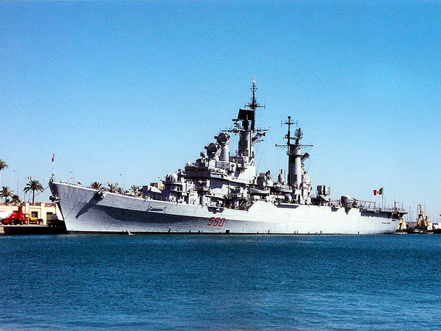
To Castellammare di Stabia
Vittorio Veneto built here 1967

Slide 7
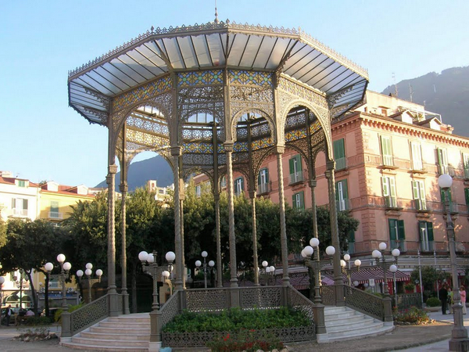
To Castellammare di Stabia
Cassa Armonica

Slide 8
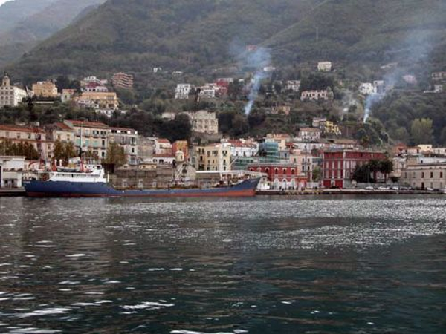
To Castellammare di Stabia
sea ​​view from the old town

Slide 9
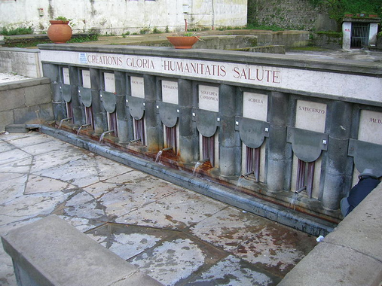
To Castellammare di Stabia
sources of aqueous baths Stabiane

Slide 10
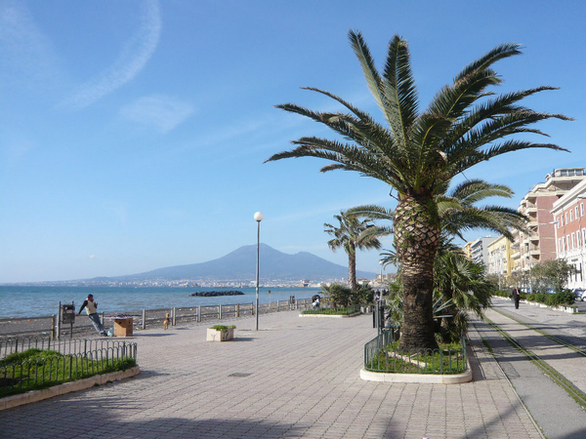
To Castellammare di Stabia
villa

Slide 11
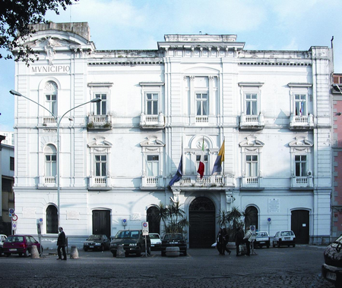
To Castellammare di Stabia
Town Hall

Slide 12
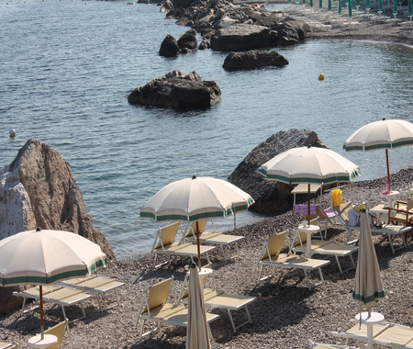
To Castellammare di Stabia
beach

Slide 13
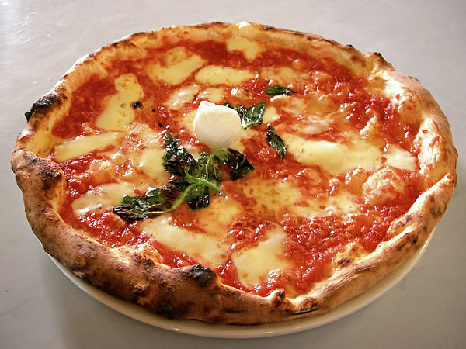
typical dishes
pizza

Slide 14
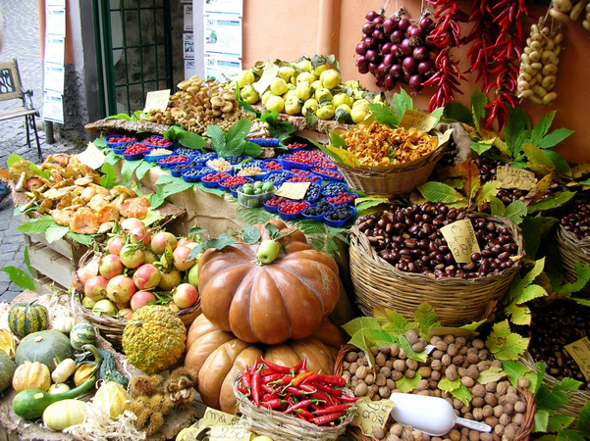
typical dishes
vegetables

Slide 15
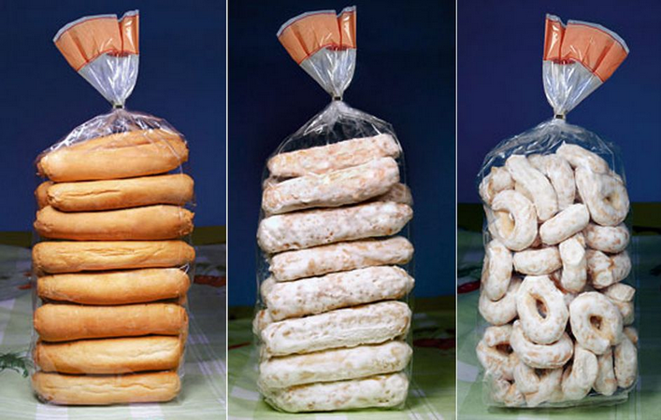
typical products
biscuits

Slide 16
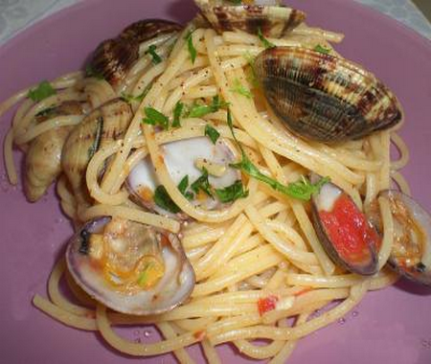
typical dishes
spaghetti with clams

Slide 17
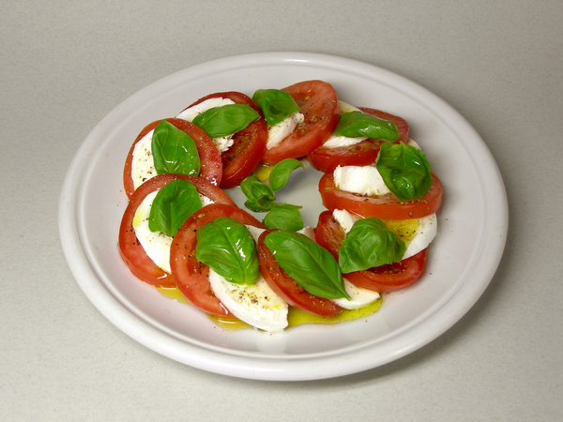
typical dishes
tomatoes and mozzarella

Slide 18
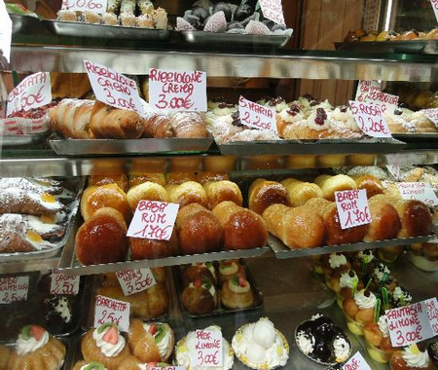
tipycal cakes

Slide 19
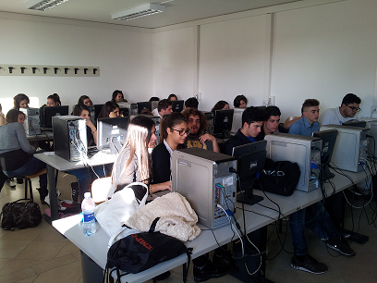
IPIA “E. Ferrari”
grafhics section

Slide 20
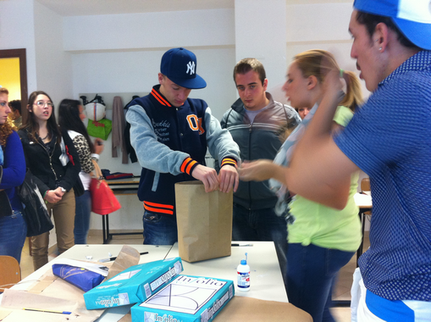
IPIA “E. Ferrari”
grafhics section

Slide 21
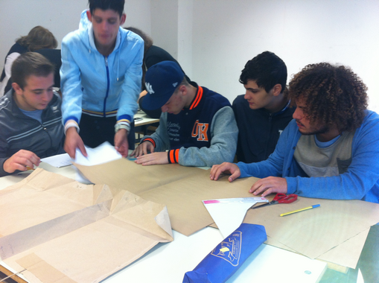
IPIA “ E. Ferrari”
graphic section

Slide 22
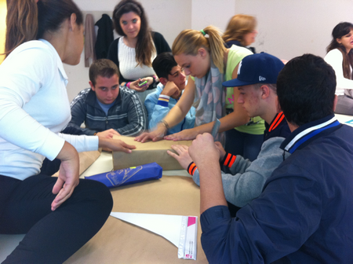
IPIA “ E. Ferrari”
graphic section

Slide 23
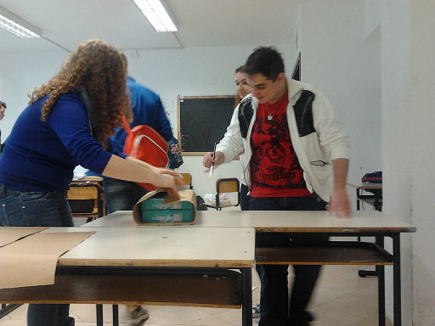
IPIA “ E. Ferrari”
graphic section

Slide 24
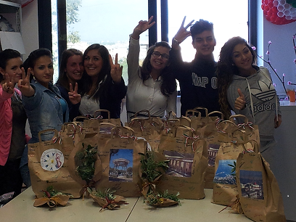
IPIA “ E. Ferrari”
graphic section

Slide 25
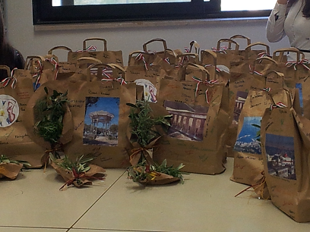
IPIA “ E. Ferrari”
graphic section

